Slide 1
Transparent RAG Framework for Document Analysis
Unlocking Trust and Insight in Document AI
Addressing core challenges in custom and sensitive documents and processes understanding for non-technical users and stakeholders.
Group 8 : Chukwudubem Ezeagwu, Mazhar Fareed, Nadia khosravany, Vinn Sunder

Slide 2




The Challenge We’re Solving
Information Overload
"Make Document AI Transparent, Visual, and Educational"
Drowning in vast, unstructured data.
Out of Date Information
Struggling to find precise, relevant answers.
AI Black Boxes
Lack of transparency in AI-generated responses.
Trust Issues
Difficulty verifying AI's factual accuracy.
Audience: Students | Researchers | Professionals | Anyone needing fast, trustworthy answers on their custom data

Slide 3
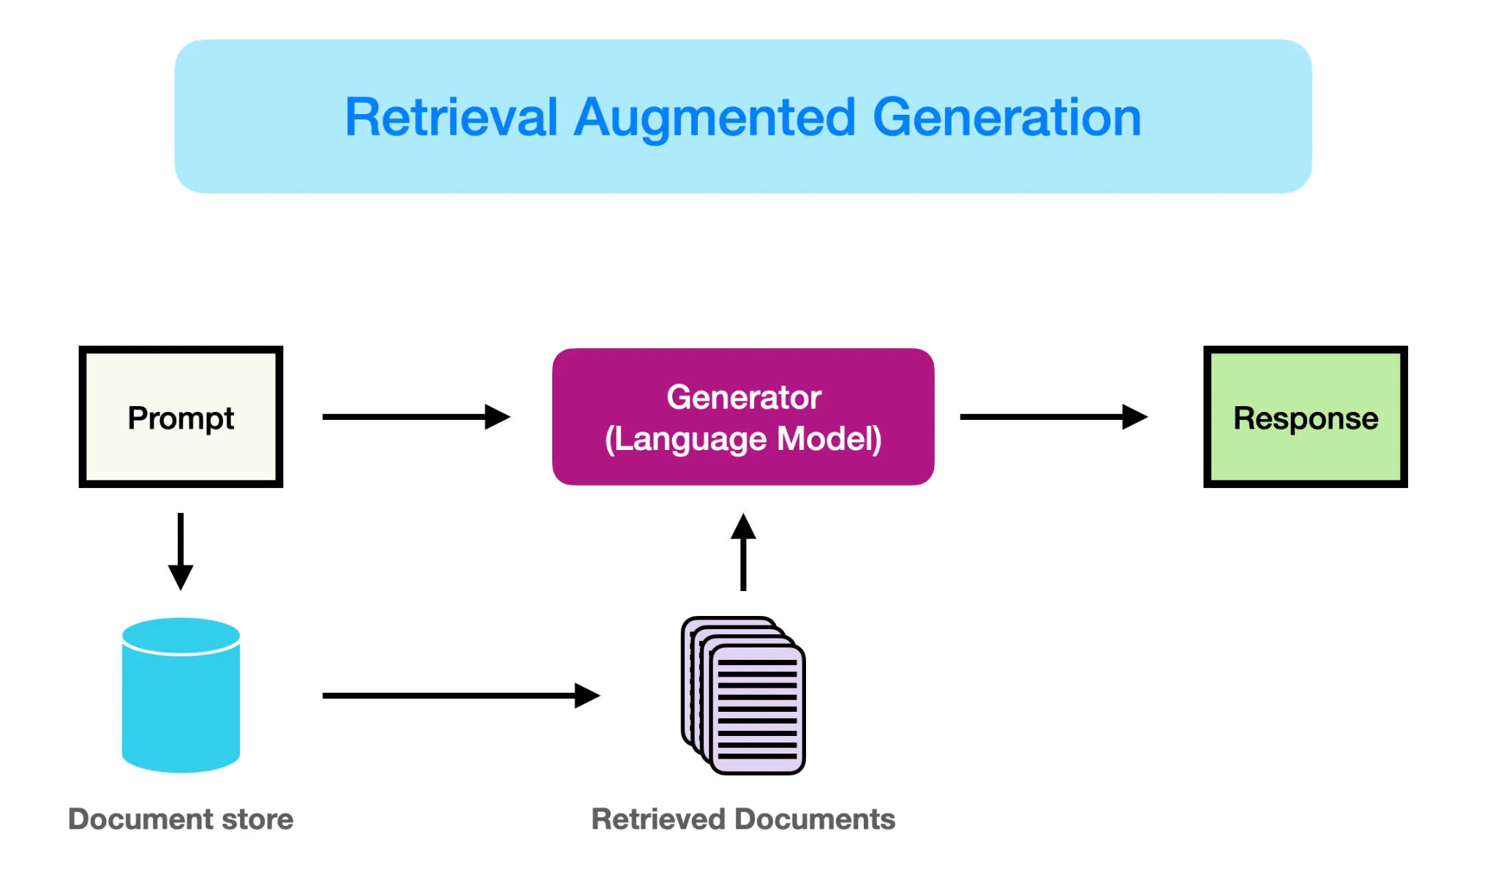
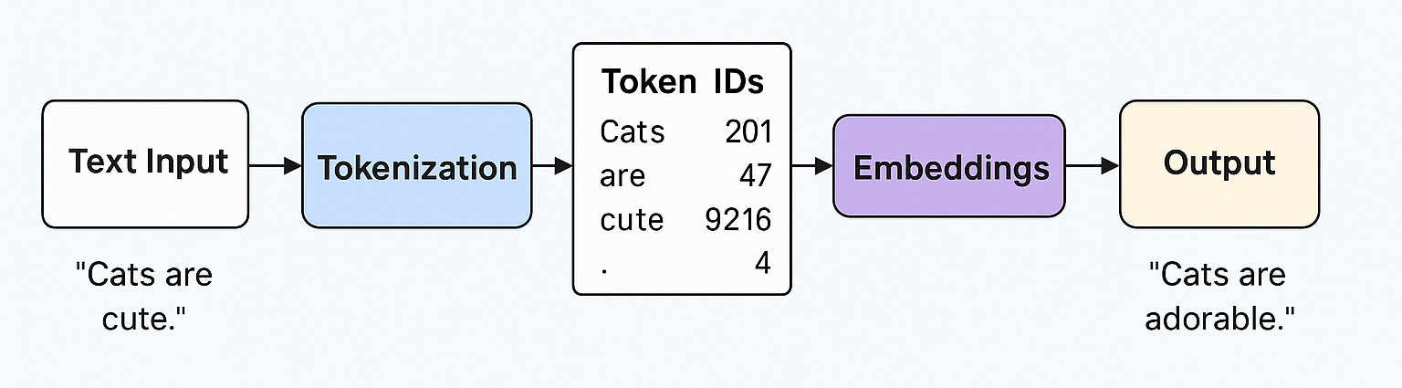
Our Solution: RAG And LLM In Action
1- RAG chart
2- RAG workflow

Slide 4
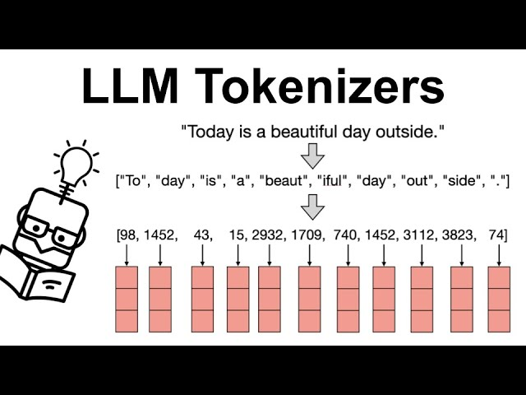
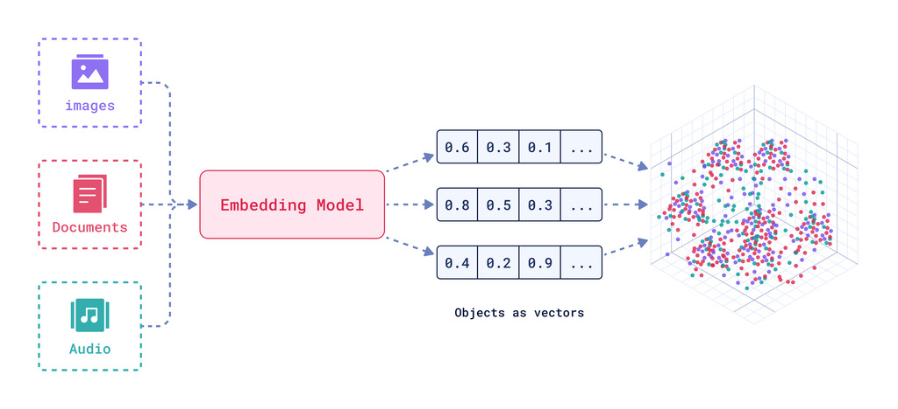
3- LLM tokenization
4- How Embedding models work

Slide 5
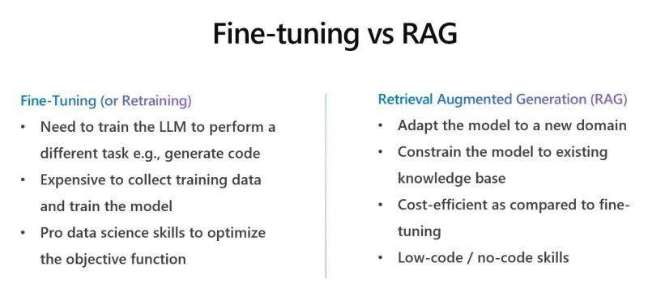



Existing Technologies
Why RAG Beats MCP / ChatGPT for Document Analysis
Always Up-to-Date – Instantly works with your latest documents without retraining or re-uploading.
Full Transparency – Shows exact chunks used in answers for easy verification.
Semantic Accuracy – Finds relevant content beyond exact keyword matches.
Scales Effortlessly – Handles thousands of docs with millisecond retrieval.
Full Control – Own the pipeline, integrate into your tools, and optimize costs.
Semantic Understanding
Source Attribution
Always Current

Slide 6
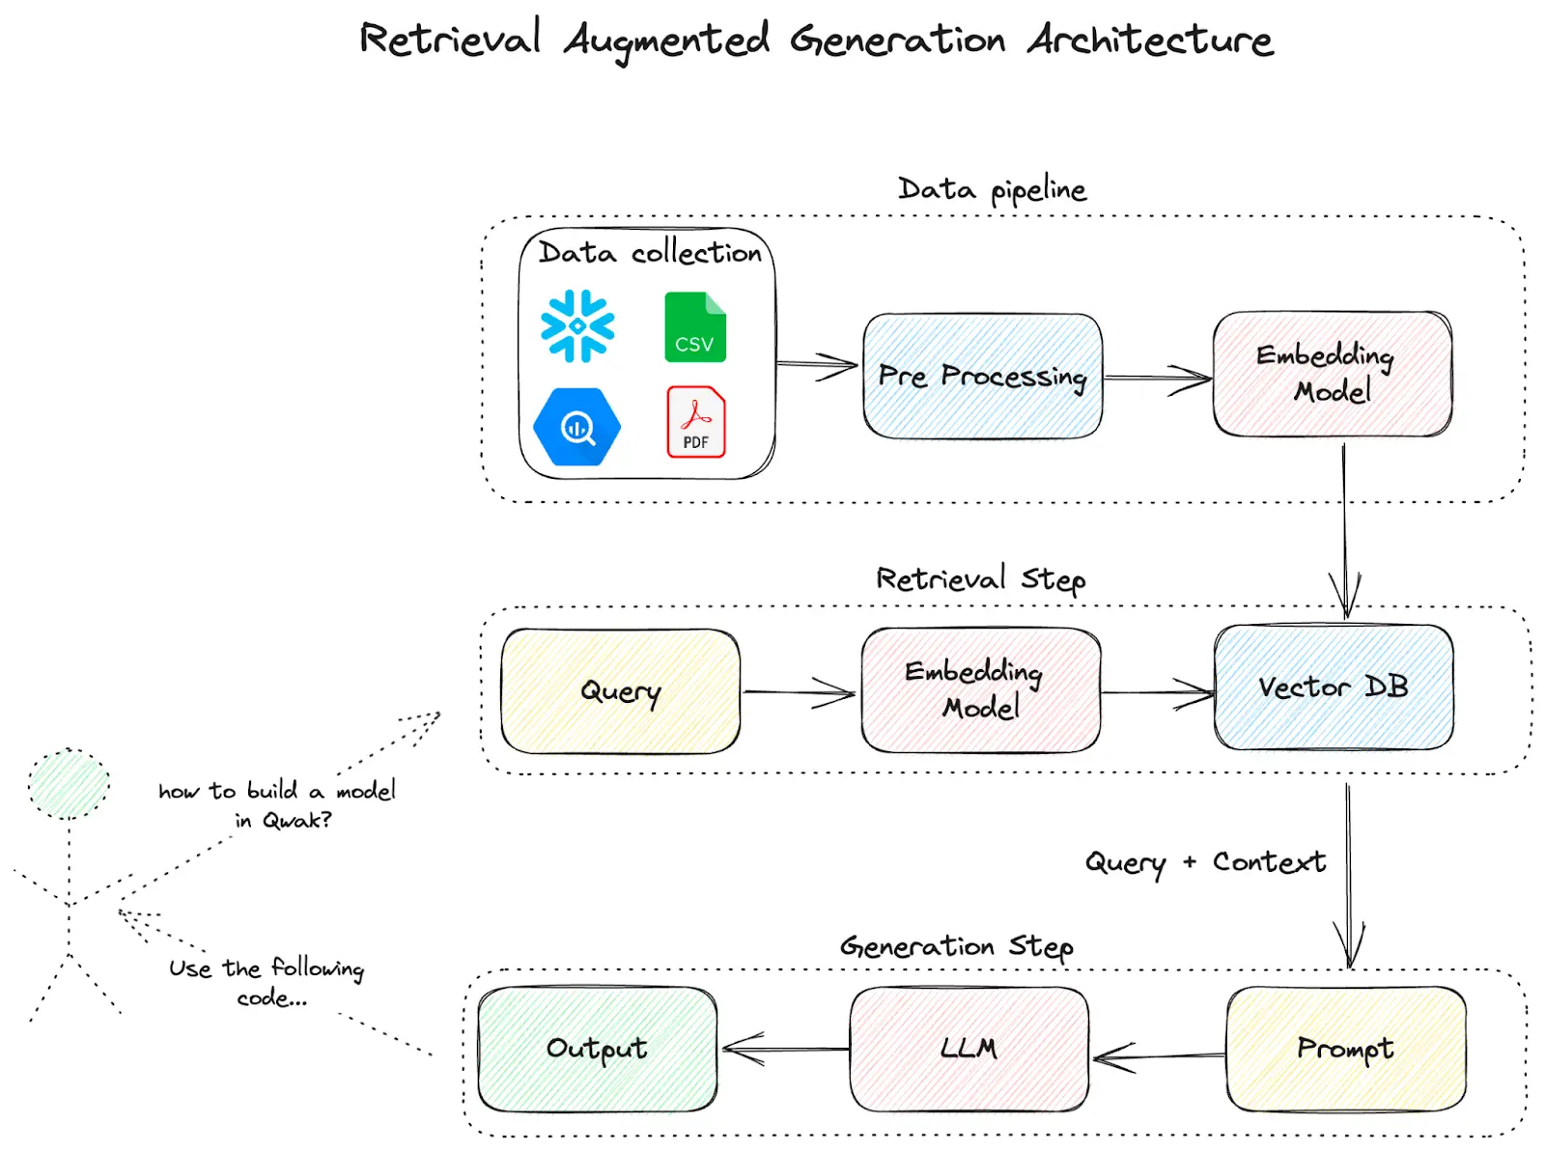
PROMPT_TEMPLATE = """
You are a helpful AI assistant that answers questions based on the provided document context.
Provide comprehensive, well-structured answers that directly address the user's question.
Guidelines:
- Answer in complete sentences and paragraphs, not bullet points
- Provide detailed explanations when possible
- Include specific examples or details from the context
- If the context contains multiple relevant pieces of information, synthesize them into a coherent response
- Use natural, conversational language
- If the answer isn't fully covered in the context, clearly state what information is missing
- Organize longer answers with clear structure (introduction, main points, conclusion)
Context from documents:
{context}
Question: {question}
Provide a comprehensive answer based on the context above:
"""
How It Works
FIG : RAG PIPELINE

Slide 7

Our Tech Stack
1
2
Document Processing
Semantic Search
Python + LangChain for chunking & enrichment.
ChromaDB + OpenAI embeddings (text-embedding-3-small)
3
4
Answer Generation
Monitoring & Analytics
gpt-3.5-turbo.
Langtrace + Streamlit visualizations.
Technical Notes: Seamless integration of LangChain with ChromaDB • Real-time query tracking with Langtrace • Streamlit dashboard for interactive exploration • Optimized embedding storage & retrieval.

Slide 8
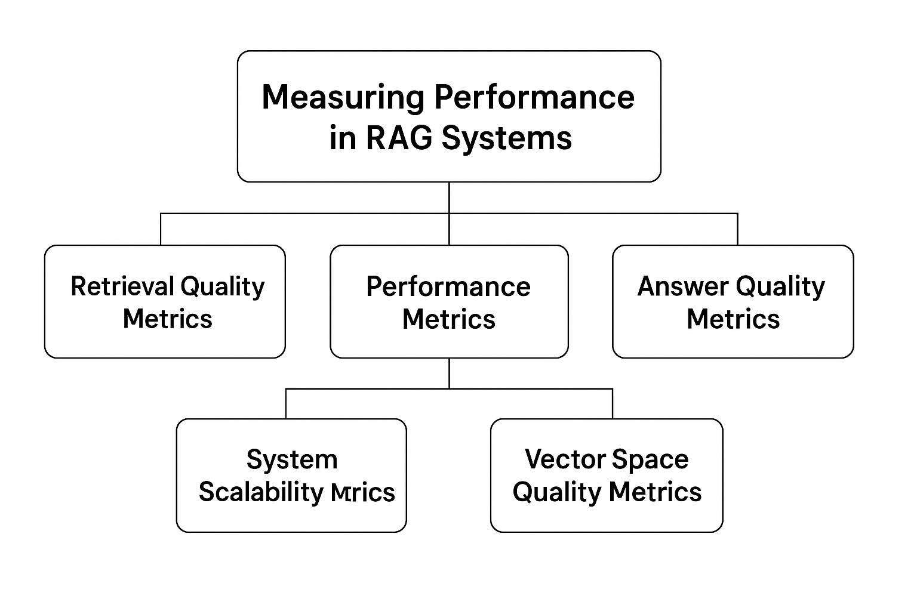
How We Measure Performance?
1- Retrieval Quality Metrics
Similarity Scores: Average, max, min similarity between query and retrieved chunks
Retrieved Documents Count: Number of chunks retrieved per query (typically 3-5)
Source Diversity: Percentage of unique sources used in retrieval
Context Length: Total characters in retrieved context
2- Performance Metrics
Response Time: Total time from query to answer (avg 2.3s)
Embedding Time: Time to generate query embedding (0.8s)
Search Time: Vector database search time (0.3s)
Generation Time: LLM answer generation time (1.2s)
3- Answer Quality Metrics
Confidence Score: Our custom 0-100% reliability estimate
Answer Length: Character count of generated response
Source Attribution: Percentage of answers with proper citations (100%)
Query Complexity: Number of words in user questions

Slide 9
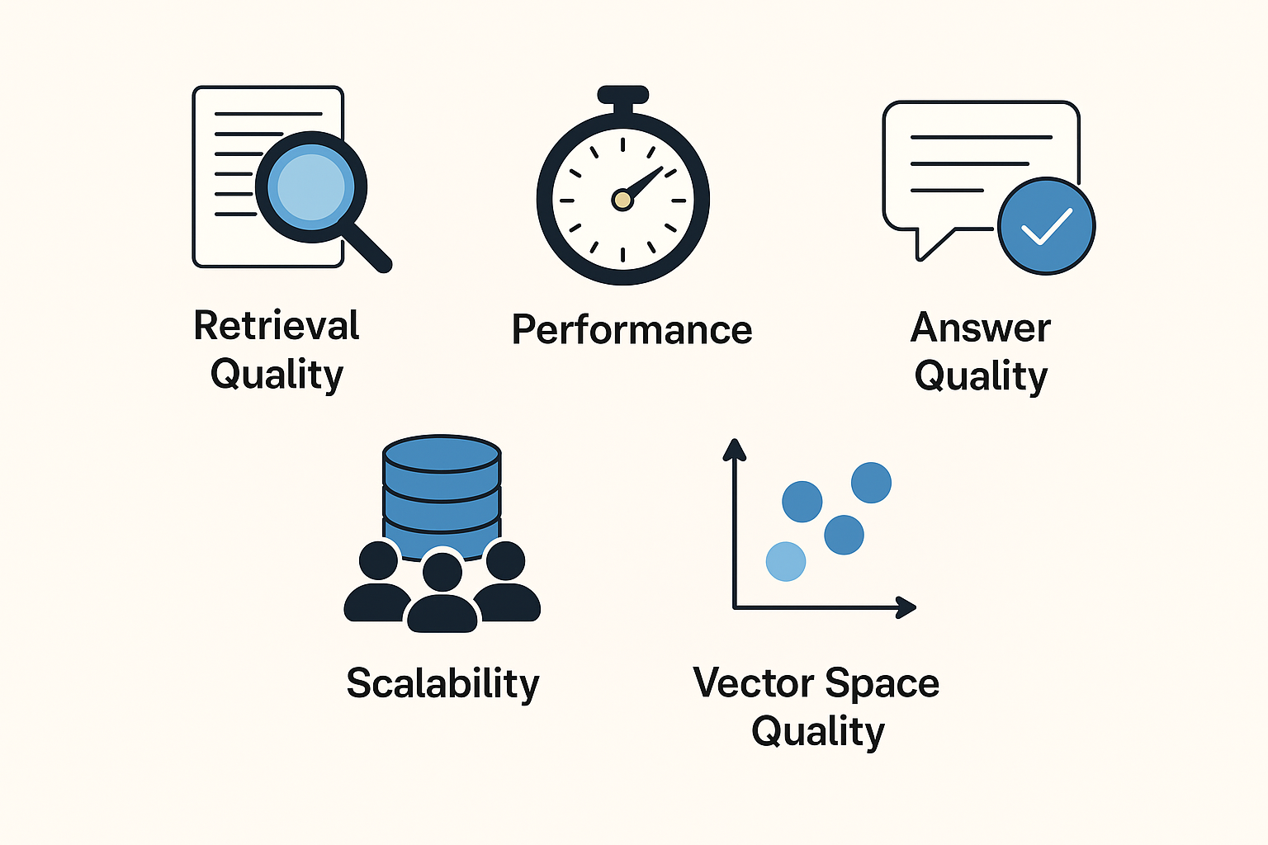
How We Measure Performance? Continued….
4- System Scalability Metrics
Database Size: Total chunks indexed (2,847 chunks)
Storage Efficiency: Vector database size (15MB)
Concurrent Users: Number of simultaneous sessions supported
Query Throughput: Queries processed per minute (10/min)
5- Vector Space Quality Metrics
Embedding Dimension: Vector size (1536D from OpenAI)
Cluster Coherence: How well similar topics group together (0.82)
Query-Document Alignment: Semantic relevance score (0.76)
Visualization Preservation: How well 2D reduction maintains relationships (UMAP: 0.89)

Slide 10
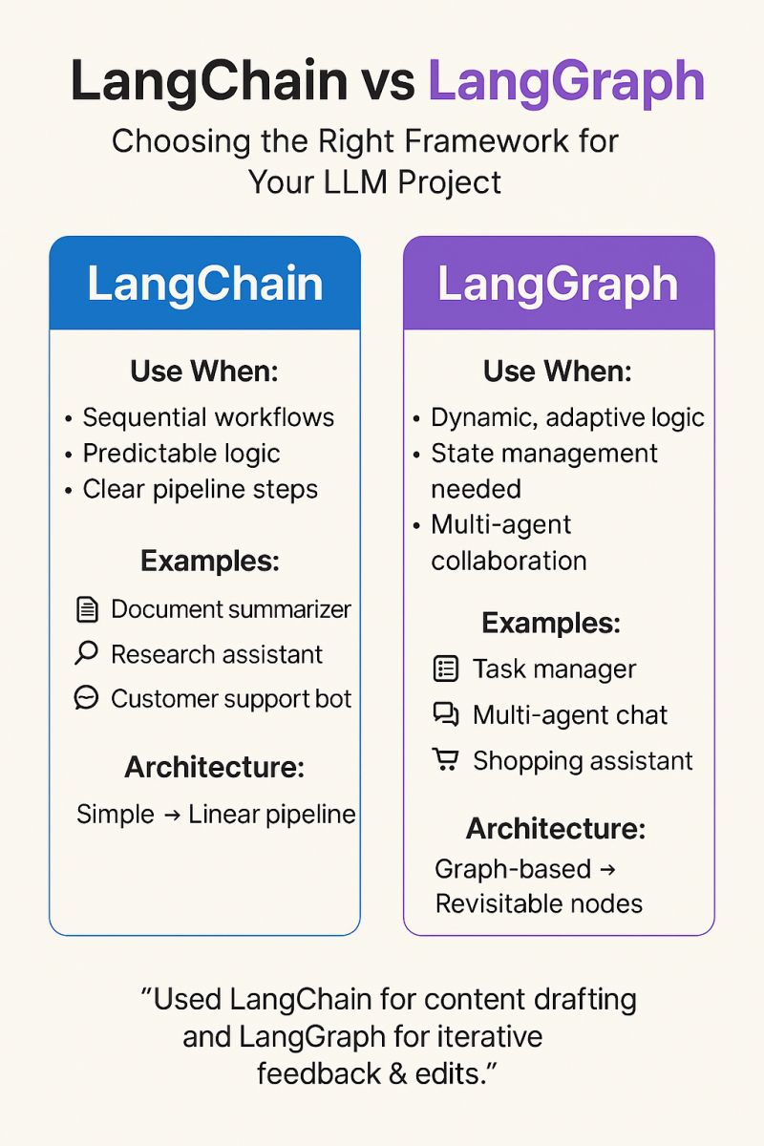
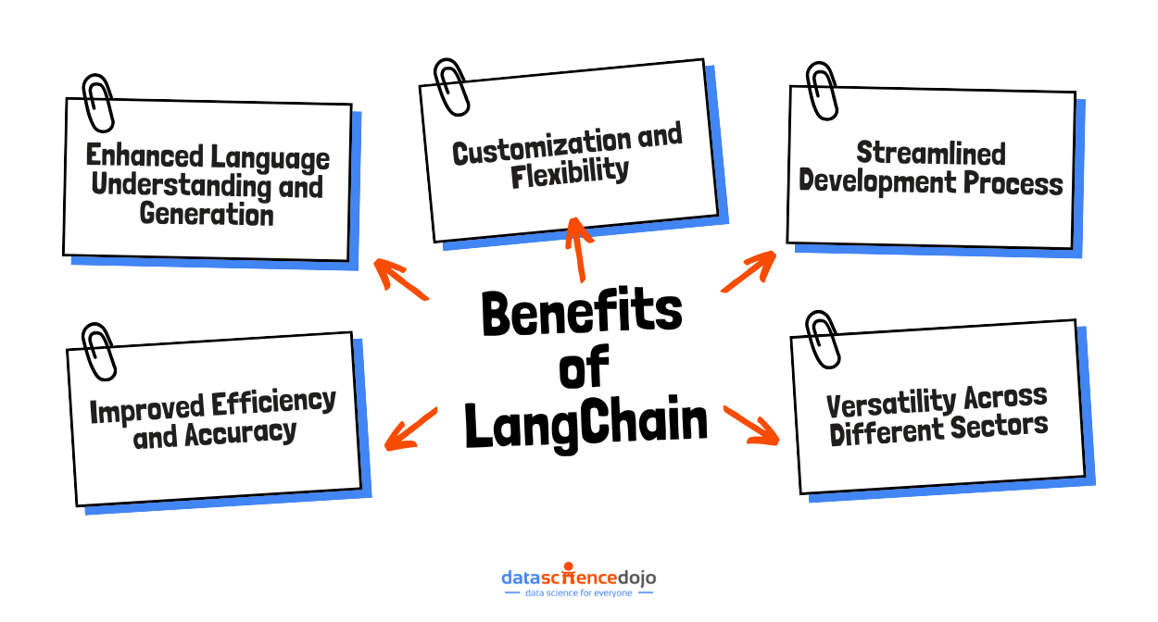
LangChain Framework
We set out to make document AI transparent, visual, and educational—LangChain gave us the flexible avenue to feasibly achieve this.
LangChain Implementation Overview
Core Orchestrator: LangChain enables flexible RAG pipeline integration.
Document Parsing: langchain-community handles diverse file formats.
Semantic Search: langchain-chroma powers fast, accurate retrieval with ChromaDB.
AI Responses: langchain-openai generates high-quality answers via OpenAI APIs.
Local Model Testing: langchain-ollama supports offline experimentation for testing models without cloud costs.

Slide 11
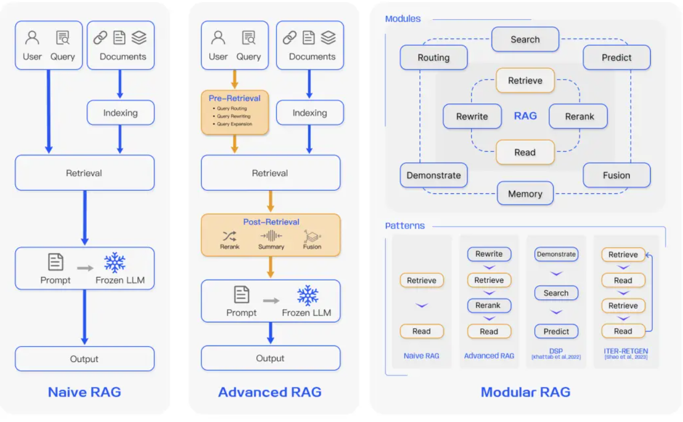
Future Endeavours and Improvements
Memory Context: Maintain conversation history for better context.
Expanded Parsing: Support for images, spreadsheets, and more.
Agentic AI Workflows: Automate decision-making processes.
Optimized Chunking: Improve retrieval speed and accuracy.
Scalability Focus: Adaptable for academia, legal, and healthcare applications.

Slide 12

References:
https://www.promptingguide.ai/research/rag
https://app.langtrace.ai/
langchain_vs_langgraph_img
LLM Internal Workflow img
https://qdrant.tech/articles/what-are-embeddings/
https://www.ampcome.com/articles/rag-vs-finetuning-which-is-best-for-your-llm-applications
Project Repository: https://github.com/vignesh-codes/rag-explorations/tree/feat/new-v1
Thank You For Listening!!!

